Slide 1


PREDICTING REMAINING USEFUL LIFE OF AIR FILTERS
Final Dissertation
Masters of Technology in Data science (School of Technology),
Pandit Deendayal Energy University
Presented by
Patel Jainil Pravinbhai (21MDS005)
M.Tech. Data Science
PDEU
Internal Guide
Dr. Shilpa Pandey
School of Technology
PDEU
External Supervisor
Nilima Gautam
Lead Data Scientist
CereBulb India Pvt Ltd

Slide 2
TABLE OF CONTENTS
Company’s Introduction
Introduction
Motivation
Objective
Literature Review & Gap
Work Flow
Dataset
Analysis
Model
Machine Learning Approach
Results
References
Page 02

Slide 3
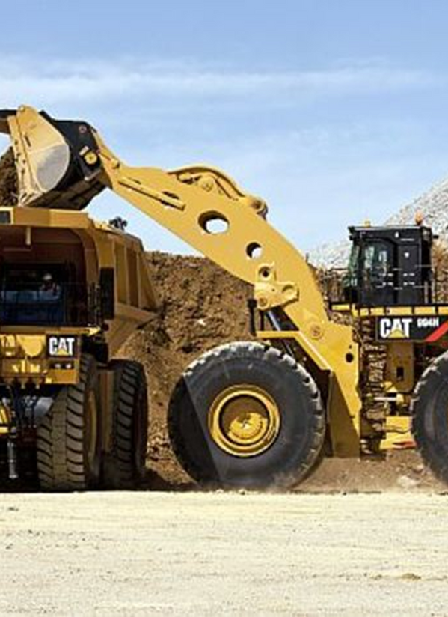
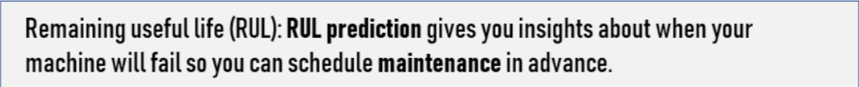
INTRODUCTION
To ensure the production/output and maintenance in mining sector the estimation of Remaining Useful Life of mining machineries is a prime.
As a consequence, the high costs in maintaining complex equipment make it necessary to enhance maintenance support systems.
Predictive maintenance plays an important factor to early detect possible defects.
An important concern in predictive maintenance is the prediction of Remaining useful life (RUL).
Page 04

Slide 4
MOTIVATION
Remaining useful life of Engine Air-Filters in mining industry is a primary concern.
The purpose of Air-Filters is to remove dust particles from entering the engine components.
For heavy vehicles like mining trucks it is assumed that the filter gets plugged at a specified value and it is recommended to change the filter.
Main aim of our approach is to provide a solution by predicting the remaining useful life of the filter & a predictive method which will identifies the cycle change and starts estimating the RUL based on the rate of KPA increment.
SERVICE
Page 05

Slide 5
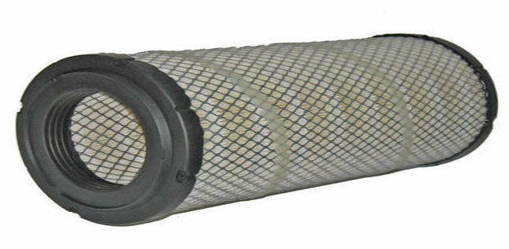
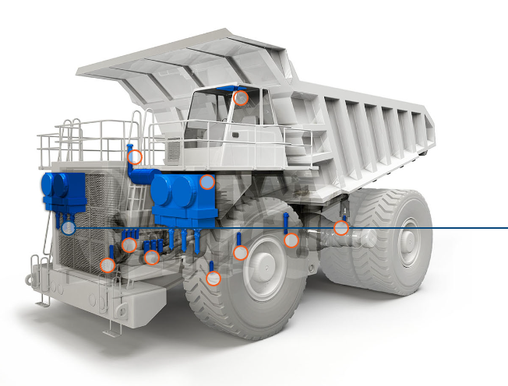
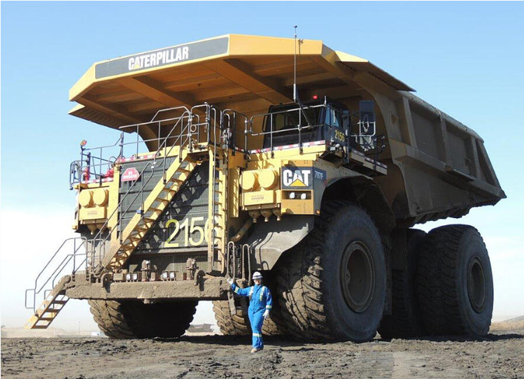

OBJECTIVE
To find the behavior of the data using statistical modelling.
To extract the cycle from the data.
To find the rate of increment in differential pressure based on the time.
To apply mathematical equation for estimating the RUL of the filters.
Fig 2
Fig 3
https://blog.iseekplant.com.au/blog/worlds-biggest-dump-trucks#:~:text=An%20ultra%2Dclass%20mining%20dump,high%20and%209.87%20metres%20wide
Page 06

Slide 6
LITERATURE REVIEW
No. | Authors | Title | Overview | Year | Publisher
1 | Hanwen Jang; Chao Jia; Maoyin Chen | Remaining Useful Life Prediction for Degradation Processes With Dependent and Nonstationary Increments | Remaining Useful Life prediction based on bifractional Browain motion. The biFBM is a process with dependent and nonstationary increments. | 2021 | IEEE
2 | B Cui, S He, X Yao | Prognostics Based on Stochastic Degradation Process | Degradation-model-based remaining useful life (RUL) estimation is essential for effective prognostic and health management. | 2018 | IEEE
Page 07

Slide 7
LITERATURE REVIEW
No. | Authors | Title | Overview | Year | Publisher
3 | Jian Xun Zhang; Dang Bo Du; Xiao Shang Si; Yang Liu | A New Method Based on Stochastic Process Models for Machine Remaining Useful Life Prediction | This paper proposes a new method based on stochastic process models for machine RUL prediction. | 2016 | IEEE
4 | Hanzong Liu; Jiacia; Li Sun | Accelerated Degradation Model of Nonlinear Wiener Process Based on Fixed Time Index | Paper based on accelerated degradation model of a nonlinear Wiener process based on a fixed time index | 2018 | IEEE
Page 08

Slide 8
LITERATURE REVIEW
No. | Authors | Title | Overview | Year | Publisher
5 | Oguz Bektas · Jeffrey A. Jones · Shankar Sankararaman · Indranil Roychoudhury · Kai Goebel | A neural network filtering approach for similarity-based remaining useful life estimation | The framework proposed in this paper considers a similarity-based prognostic algorithm that is fed by the use of data normalization and filtering methods for operational trajectories of complex systems. | 2018 | IEEE
6 | Martin Weston & Robert Taylor | Remaining Useful Life Estimation of Caterpillar Vehicle Compartments | This project identifies which elements of the oil are most important in the identification of failures and constructs a statistical model using oil sample data in conjunction with failure history in order to estimate compartment Remaining Useful Life (RUL). | 2020 | IEEE
Page 09

Slide 9

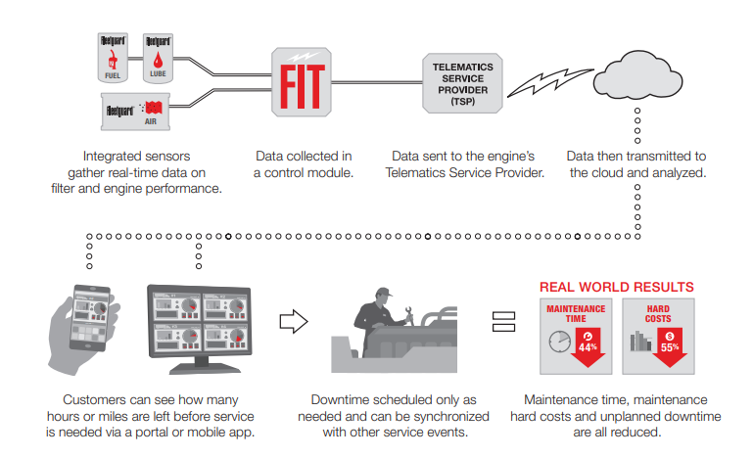
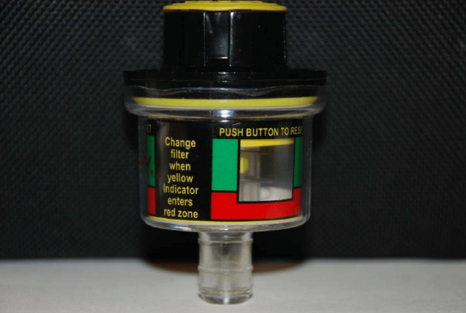
WORKFLOW
INPUT
DATA
DATA
PROCESSING
MODELSELECTION & EVALUATION
RUL
CALCULATION
LABELLING
OUTPUT
Input raw data needs to be processed
Raw data is cleaned &
unwanted data is removed
Labelling the clean data according to the requirements
Selecting the statistical model for predictive maintenance
Remaining useful life calculation based on history data
Early Failure detection to overcome the breakdown
Air Filter Indicator
Fig 4
https://www.donaldson.com/en-in/engine/filters/products/air-intake/cleaners/ssg/
Page 10

Slide 10
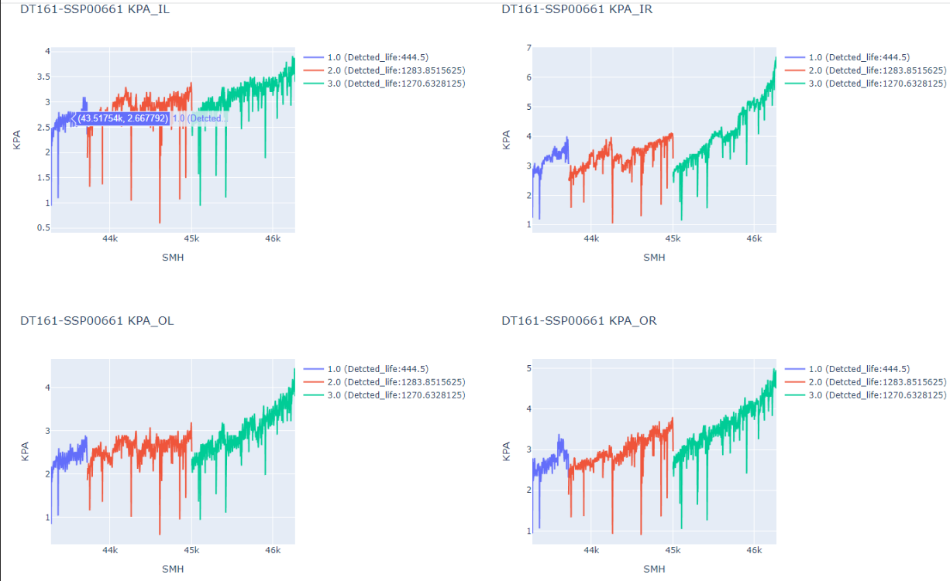
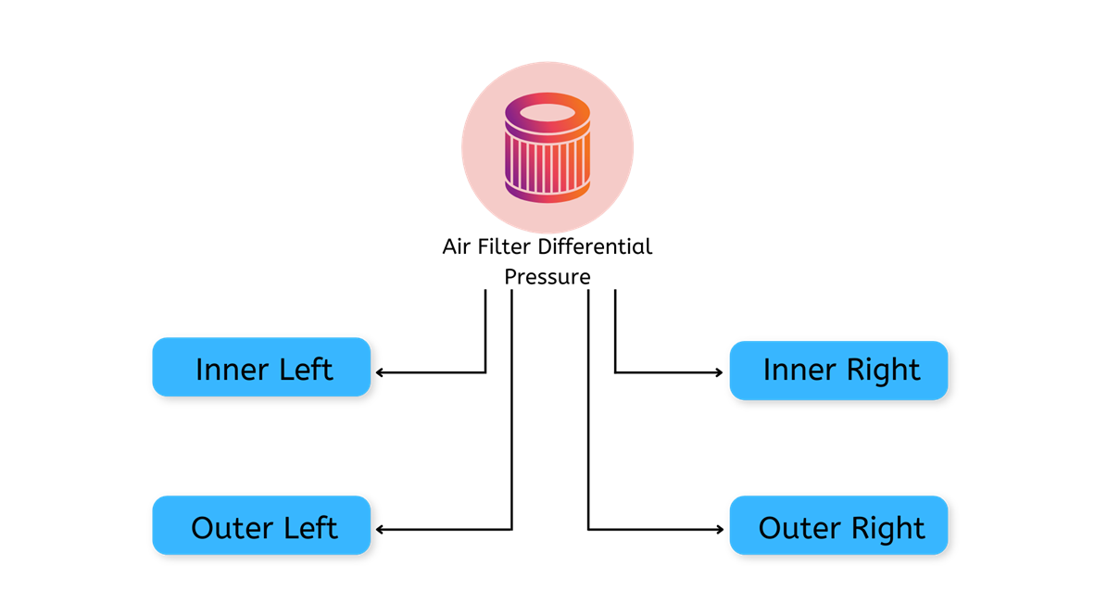
DATASET
There are four parts of filters in a mining vehicle.
1.Inner Right Air-Filter
2.Inner Left Air-Filter
3.Outer Right Air-Filter
4.Outer Left Air-Filter
Fig 6
Fig 5
Data was collected from 65 different Vehicles at random time intervals
Page 11

Slide 11
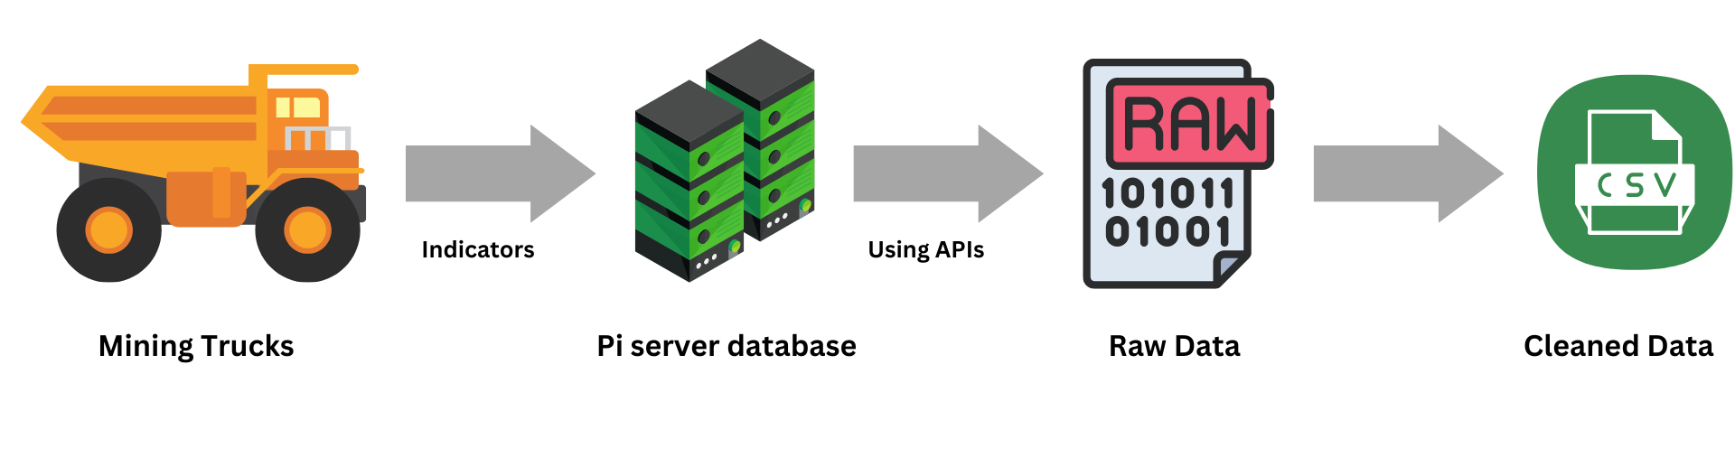
DATASET
Dataset consist of following features
Tag Name | Description
KPA | Kilopascal
SMH | Short Maintenance Haul
Filter | Filter
INR_LT_Time | Inner left filter time
INR_LT_KPA | Inner Left KPA
OTR_LT_time | Outer left KPA
INR_RT_Time | Inner Right Time
INR_RT_KPA | Inner Right KPA
OTR_RT_time | Outer Right time
Specifically, there are 65 trucks in the dataset, with each truck containing 87977 datapoints.
Page 12

Slide 12
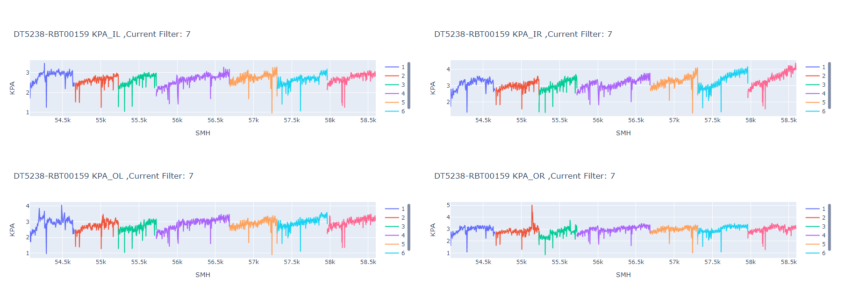
ANALYSIS
Graphical view of filter cycles
Fig 8
Page 13

Slide 13
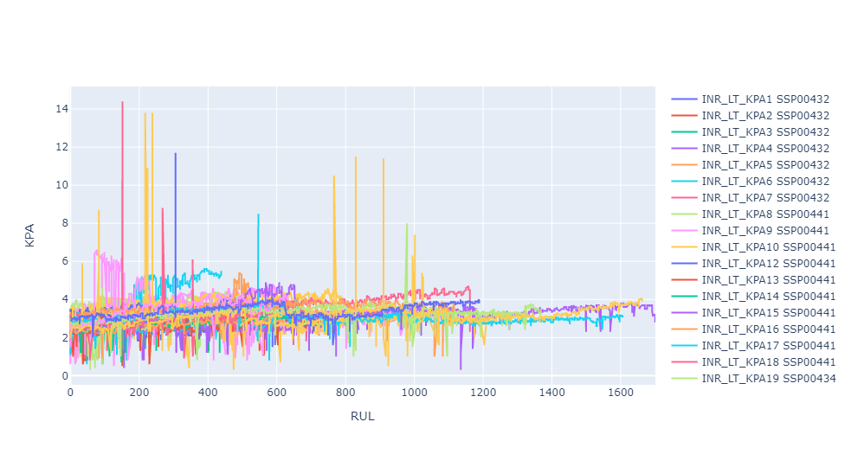
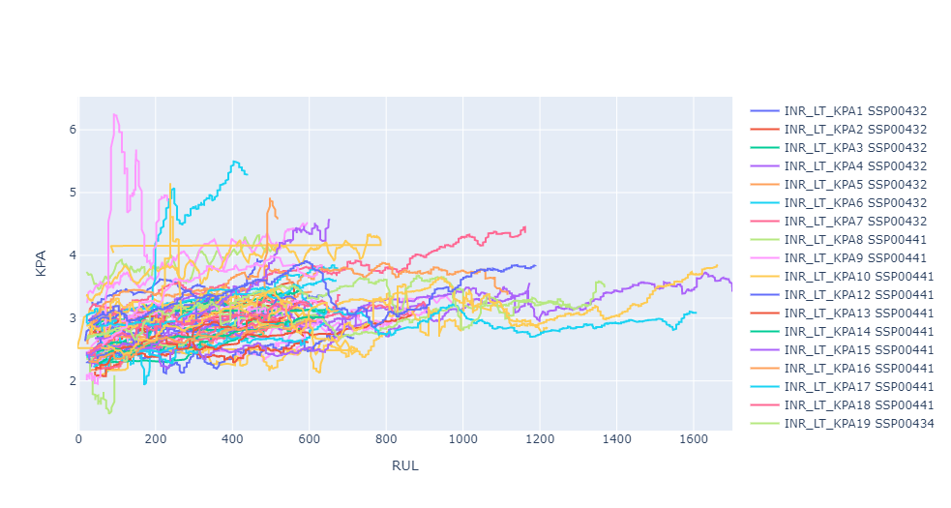
ANALYSIS
Based on raw data graphical view, smoothen data graphical view and sudden drop in KPA value we consider it as end of life of filter and start of new filter.
Using this analysis we have identified 65 INRLT filters from all vehicle data. Which are as below in graph:
Fig 9
Fig 10
On above plot, the x-axis shows the RUL (Life time ), and the y-values represent KPA values at each SMH.
Each Filter starts in a healthy state and ends in failure.
Page 14

Slide 14
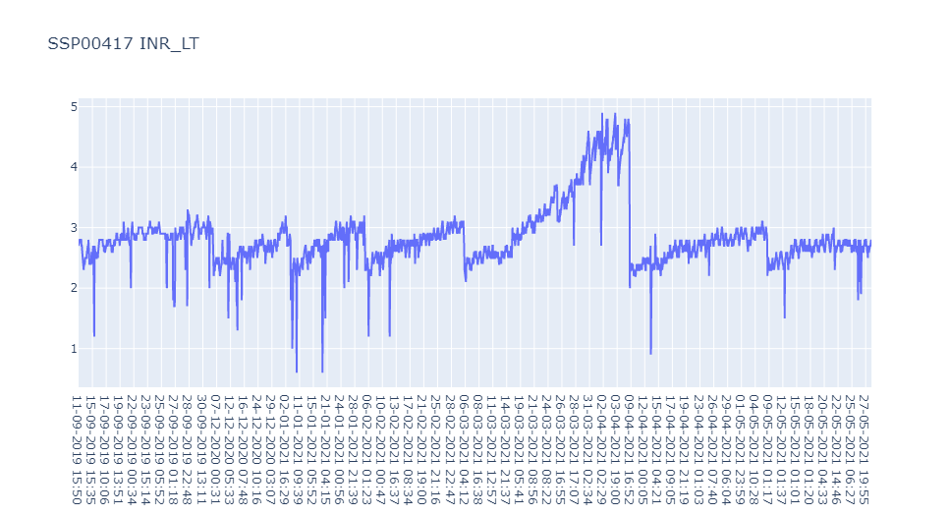
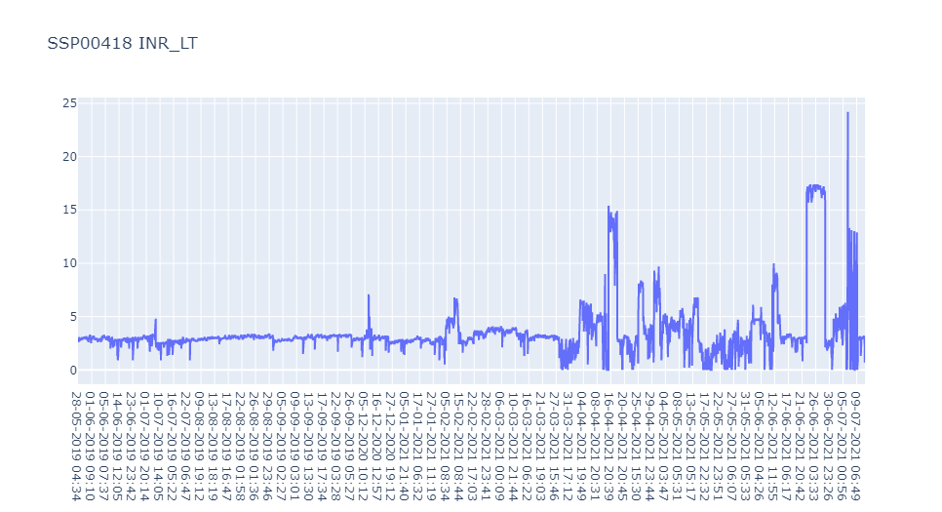
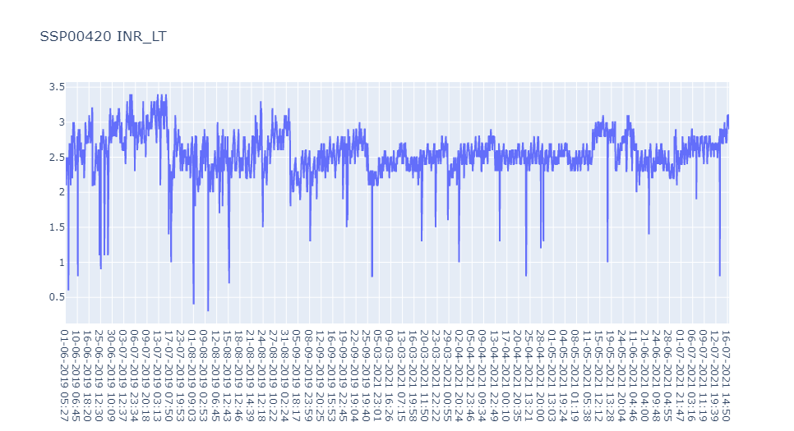
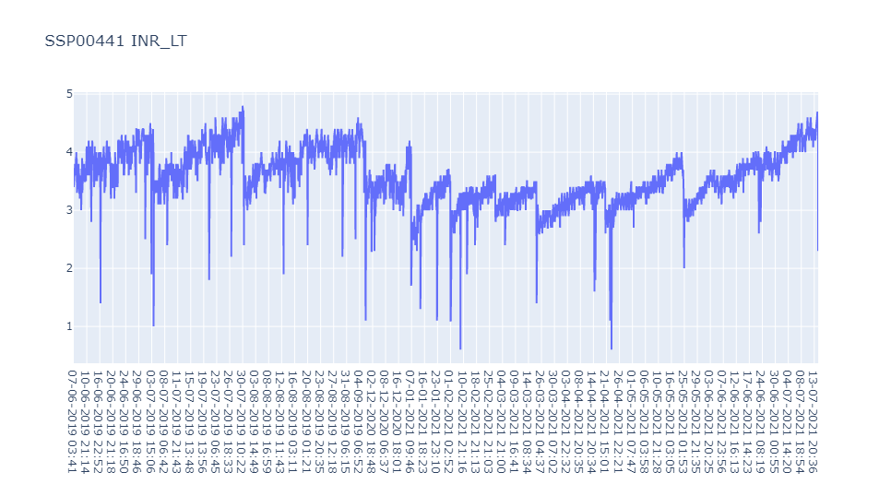
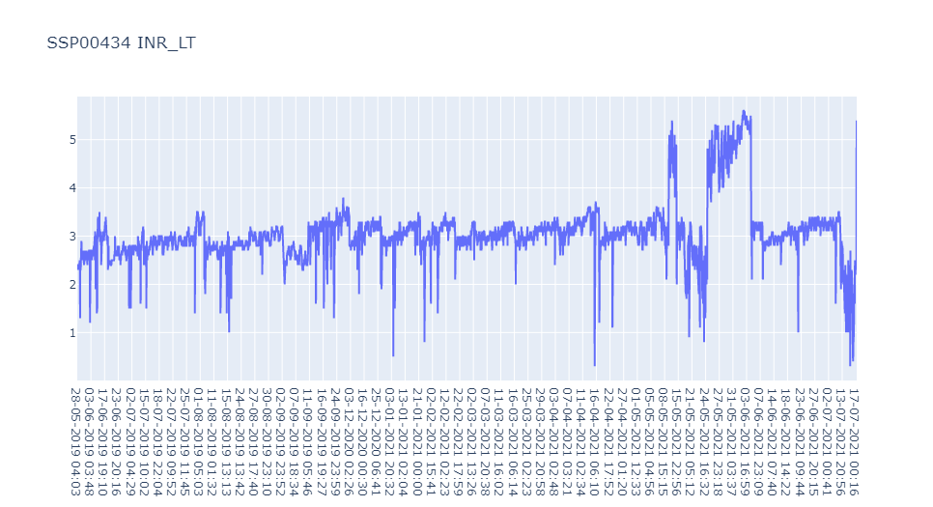
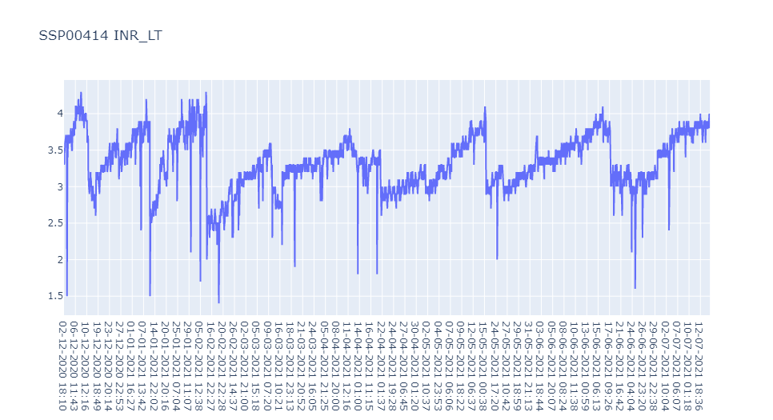
ANALYSIS
Inner left Filter graphs of all truck
Unwanted Data
Incomplete cycle
Page 15

Slide 15
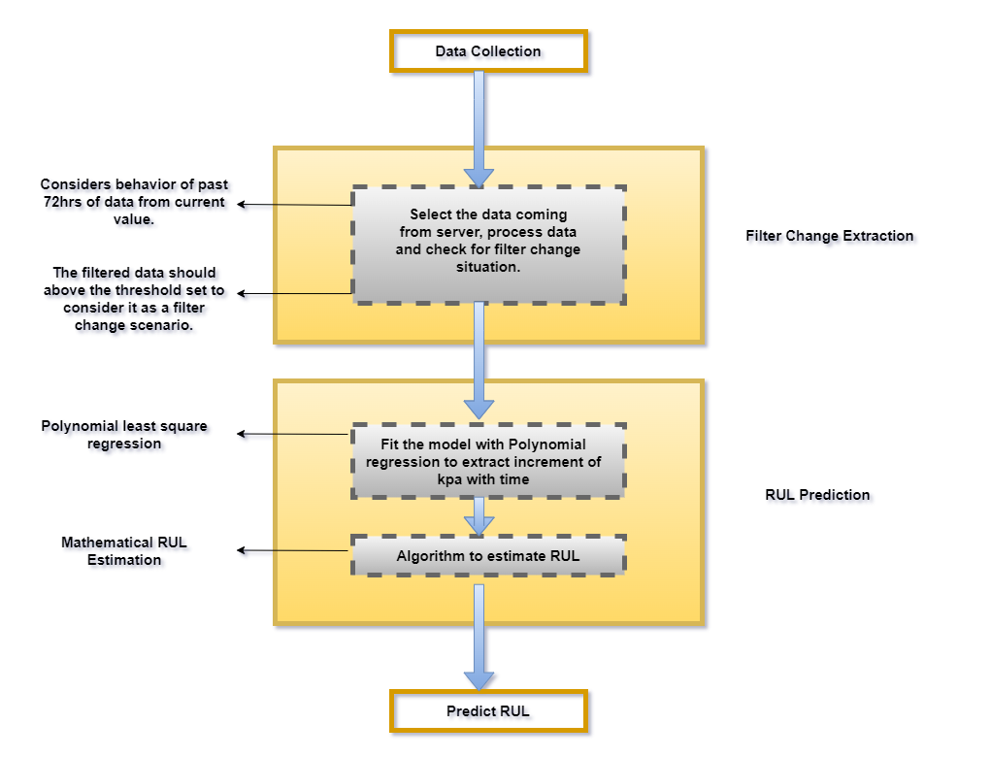
RUL
WORKFLOW
Fig 12
Page 16

Slide 16
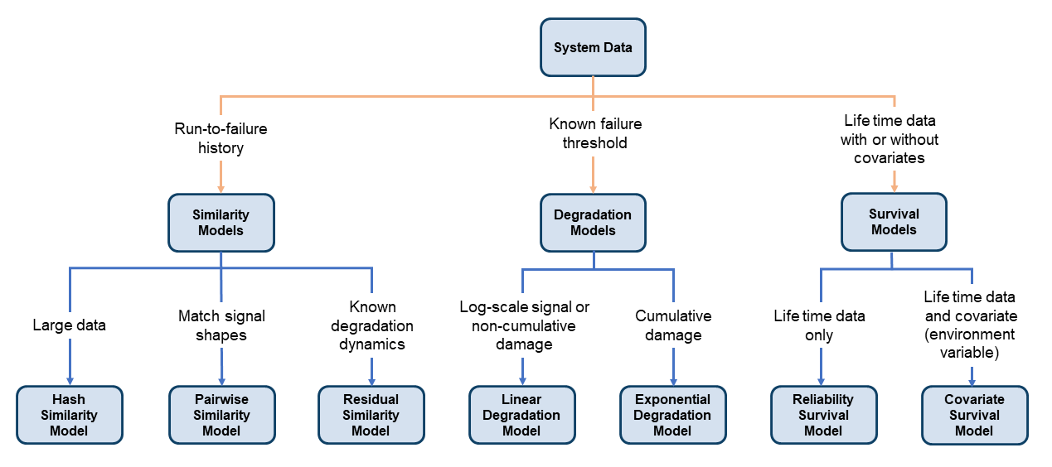
RUL Estimator Models
Fig 13
Page 17

Slide 17
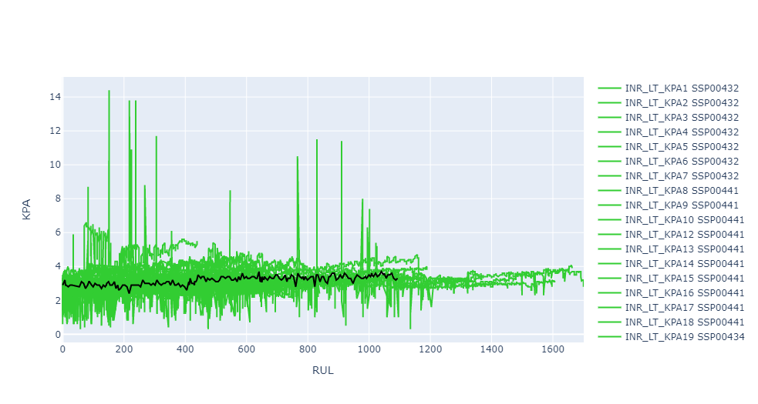
MACHINE LEARNING APPROACH
KNN Output
Similarity model
The similarity model is a useful RUL estimation technique.
The similarity model works by finding the closest filter profiles to current filter KPA up to the current SMH.
Fig 14
filter KPA up to the current SMH
Historical Remaining useful life of different filter
Current filter
At each iteration of the RUL computation, similarity model finds the closest filter paths, which are shown in green, and computes the RUL using nearby value.
Page 18

Slide 18
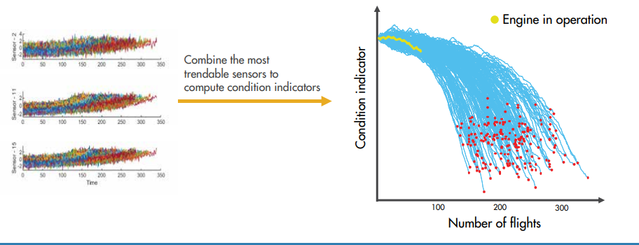
MACHINE LEARNING APPROACH
KNN Output
There is a relatively large error between the estimated RUL and the true RUL when the filter is in an intermediate health stage.
In this example, the most similar 10 curves are close at the beginning, but bifurcate when they approach the failure state, resulting in roughly two modes in the RUL distribution.
With Nasa’s engine dataset
Fig 15
Page 19

Slide 19

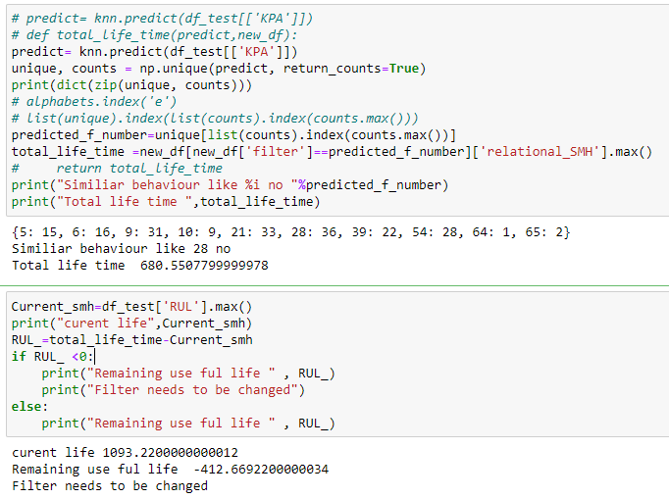
MACHINE LEARNING APPROACH
INPUT
Current filter KPA up to the current SMH
OUTPUT
Page 20

Slide 20
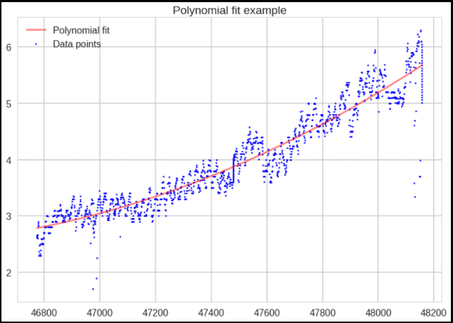
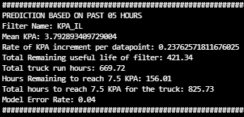
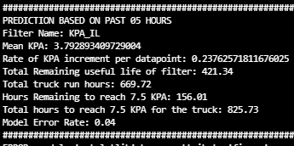
MACHINE LEARNING APPROACH
Polynomial regression performed to get best fitted KPA increments
Mathematical RUL Estimation
Fig 16
Page 21

Slide 21
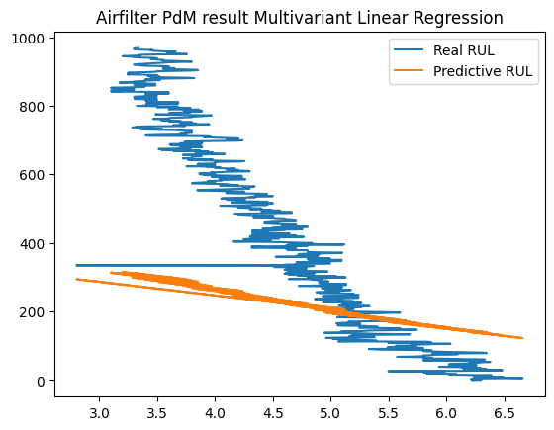
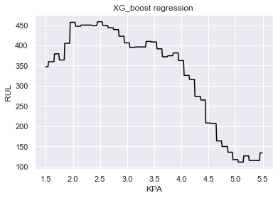
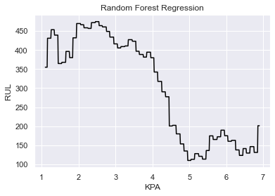
MACHINE LEARNING APPROACH
Page 22

Slide 22
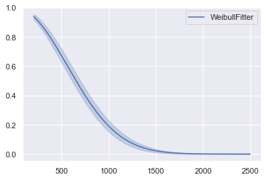
MACHINE LEARNING APPROACH
Survival analysis
For Survival analysis ,WeibullFitter Fits the best among other fitters.
Total probability of survival till that time interval is calculated by multiplying all the probabilities of survival at all time intervals preceding that time (by applying law of multiplication of probability to calculate cumulative probability).
100% probability of surviving the first 128 SMH
The Weibull curve provides us with some initial information of survival probabilities
40% probability of surviving for 600 SMH
10% probability of surviving for 1200SMH
Fig 18
Page 23

Slide 23
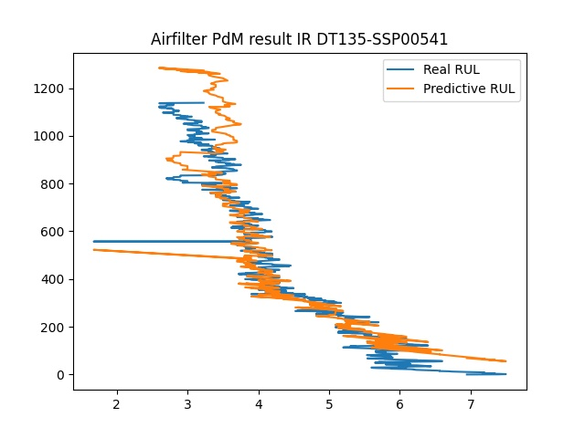
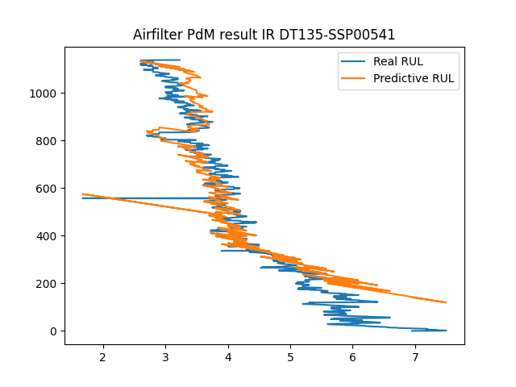
MACHINE LEARNING APPROACH
Hybrid Model
Linear Model + Survival Model(Weibull fitter)
Survival model- WeibullFitter, Exponential Fitter, Log-NormalFitter, Log-LogisticFitter, NelsonAalenFitter, PiecewiseExponentialFitter, GeneralizedGammaFitter, SplineFitter and Kaplanmeir fitter models are available.
WeibullFitter is best fit to our filter lifeline shape.
Page 24

Slide 24
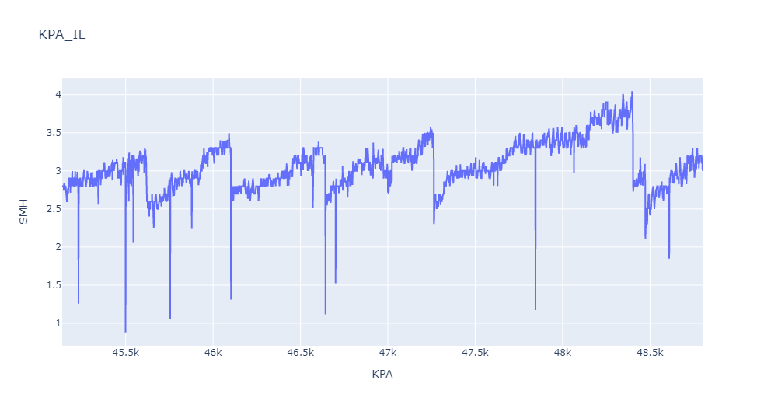
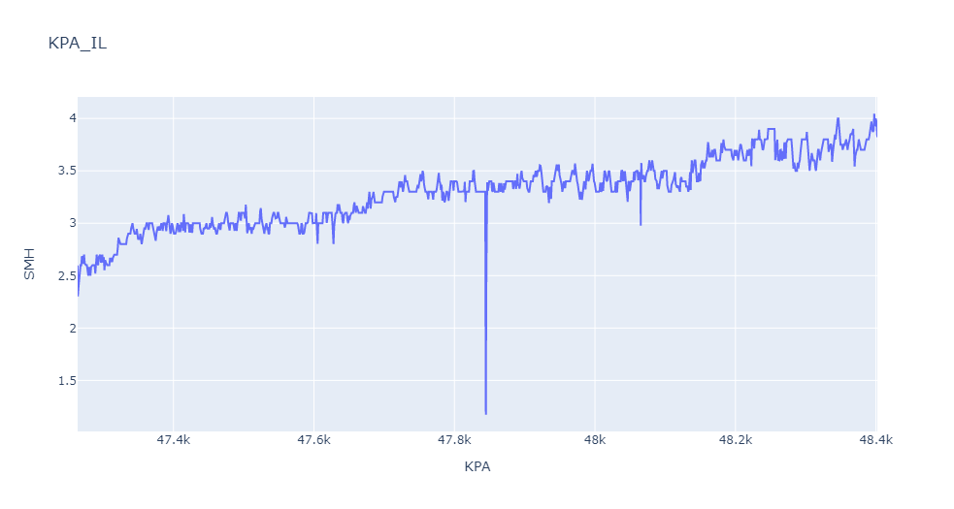
MACHINE LEARNING APPROACH
Analysis of Hybrid Model
Air filter Pugged In/OUT – Sudden drop in KPA value and after that continues uptrend KPA value is considered as filter change.
Page 25

Slide 25
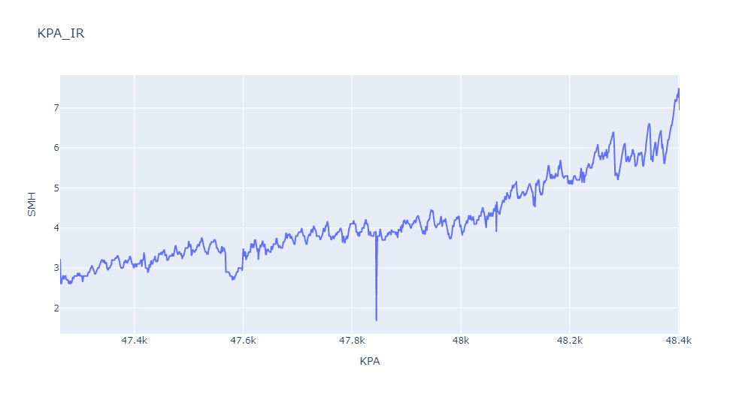
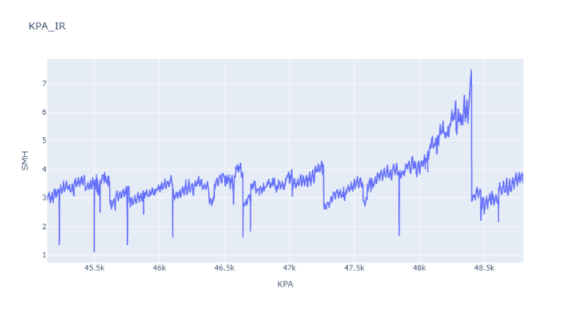
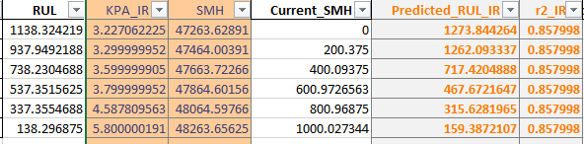
MACHINE LEARNING APPROACH
Actual RUL
Analysis of Hybrid Model
Predicted RUL
Actual RUL=last SMH – Current SMH
Input=[KPA,SMH]
Current_SMH = Current reading – First reading
Mlmodel=LR+Weibull
As filter last to 7.0 KPA so predicted
RUL value will last for 20 hours.
Page 26

Slide 26
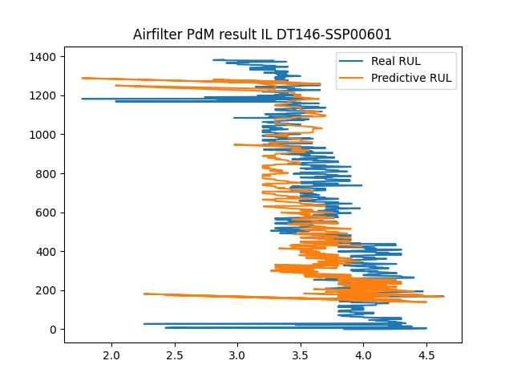
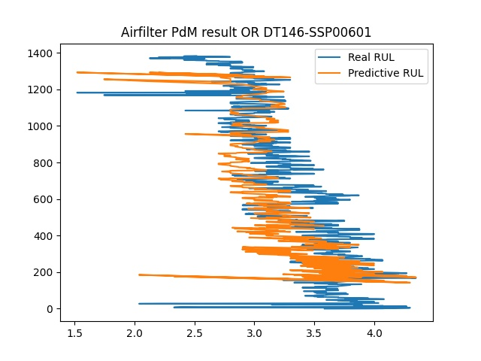
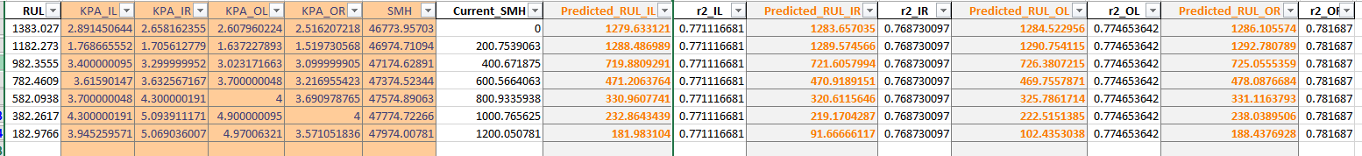
MACHINE LEARNING APPROACH
Page 27

Slide 27
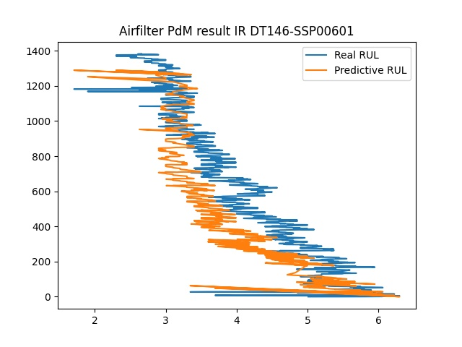
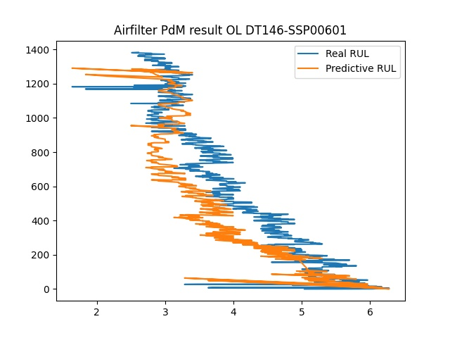
MACHINE LEARNING APPROACH
Page 28

Slide 28
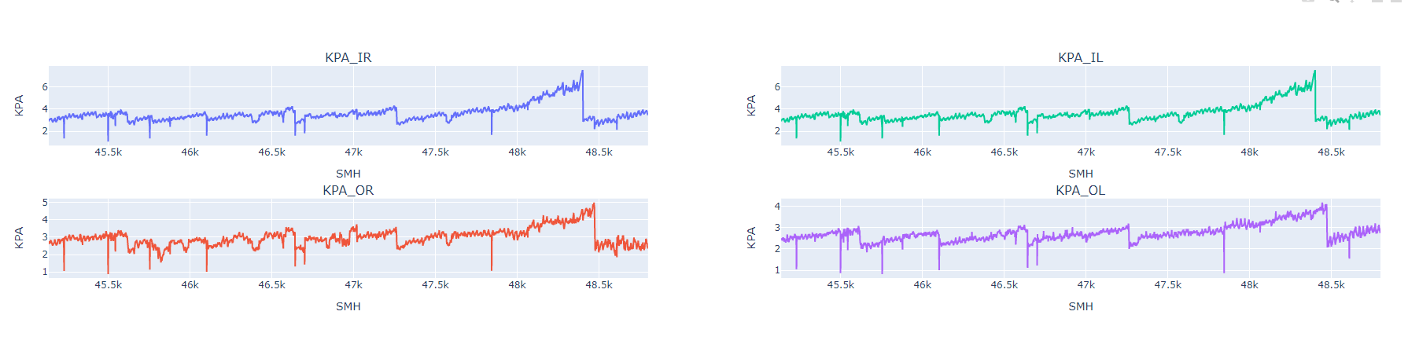
RESULTS
Filter change cycle considered for analysis
Page 29

Slide 29
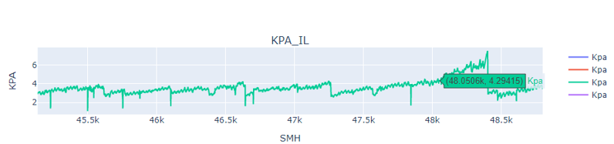
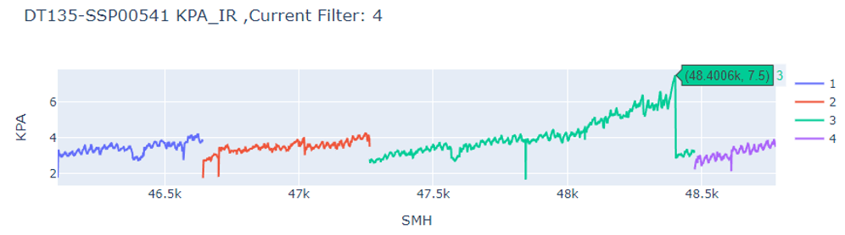
RESULTS
Actual RUL 348hrs
Filter data considered for analysis
In actual case from the pointer of 4.29kpa to reach the End point of 7.5 kpa, it took 348 hrs.
I.e 48400.6-48052.6 = 348 hrs
Actual End Point
Page 30

Slide 30
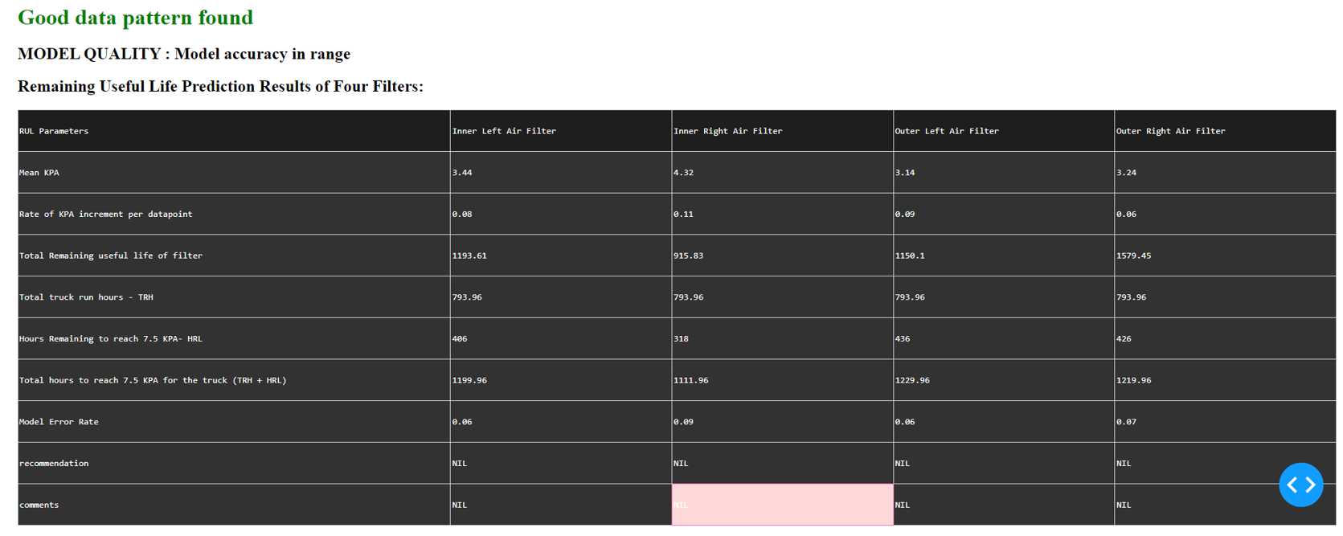
RESULTS
Inner Right Air Filter
In actual case from the pointer of 4.29kpa to reach the End point of 7.5 kpa, it took 348 hrs.
i.e, 48400.6-48052.6 = 348 hrs
Predicted result gives an RUL of 318 hrs to reach 7.5 kpa and a total RUL of 915 hrs as an end of filter lifetime.
Actual 348 hrs – predicted 318 hrs => 30 hrs
Page 31

Slide 31
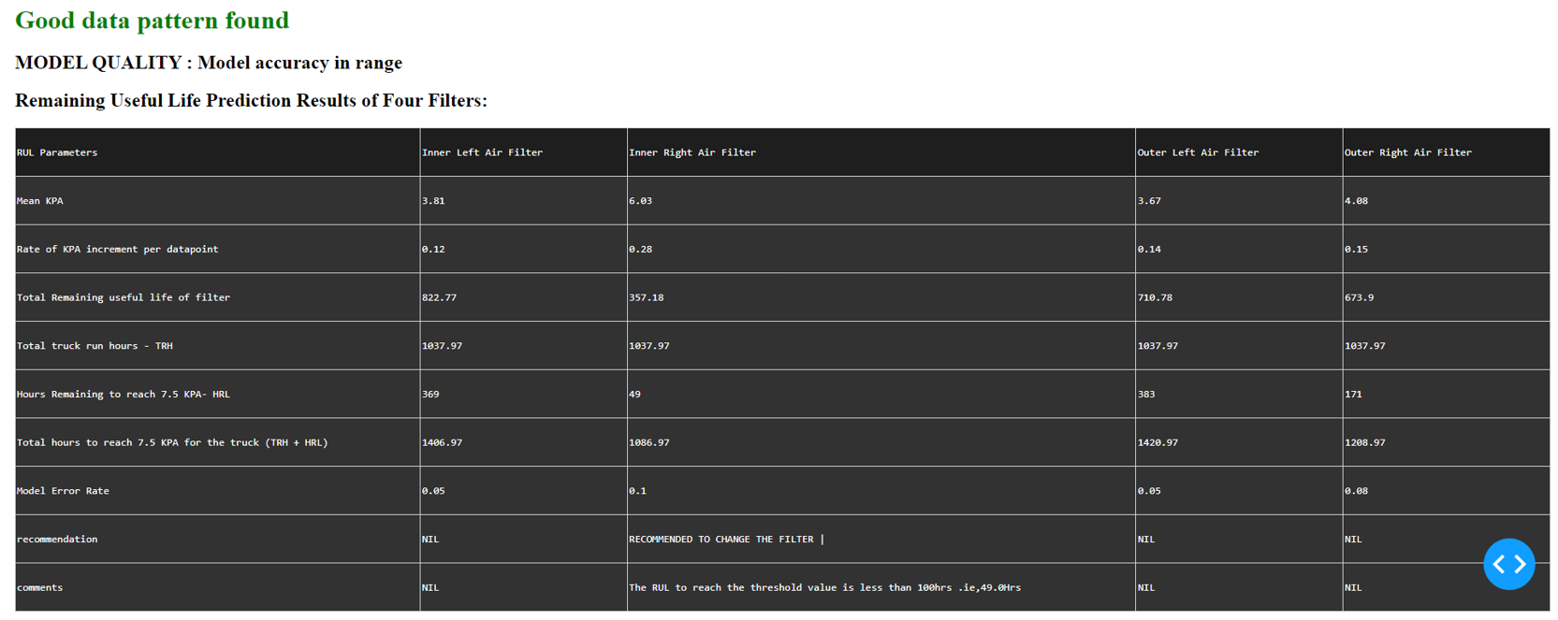
RESULTS
Recommendation to change the filter based on increment in kpa.
Indicates RUL to reach 7.5kpa < 100 hrs.
Page 32

Slide 32
CONCLUSION
KNN – With time we get more accurate RUL , This model completely depends on history data with RUL value. Need more and complete cycle data for better accuracy.
Regression – Linear ,Polynomial ,random forest regression and milliner regression bound around 600 and last at 150 hour remain at 7.5 KPA value – error is comparatively high than KNN model. Need more and complete cycle data for better accuracy.
Survival model- WeibullFitter, Exponential Fitter,LogNormal Fitter, LogLogistic Fitter, NelsonAalen Fitter, PiecewiseExponential Fitter, Generalized GammaFitter, Spline Fitter and Kaplanmeir fitter models are available. Weibull Fitter is best fit to our filter lifeline shape.
Binary classification- To predict filter is alive or not so not very useful In RUL estimation. However to for this we have very imbalance data (class 0: 97% ,class 1 : 3% only).
Statistical model – linear model is complete data driven equation as we get mode data it automatically change its constant. Sometime constant are too low so rul become very large.
In growth model as time passed model we get more accurate Rul and it follow the forecast curve, but in initial hours it give large error.
Hybrid model : hybrid model is combination of 3 model 2 linear regression and weibull fitter. Out of all above models this model give far better results and its accuracy about >90%.
Page 33

Slide 33
CONCLUSION
There are several potential future directions for research in the area of predicting the remaining useful life of air filters in mining trucks:
Integration with maintenance decision-making
Predictive maintenance
Improved prediction models: There is room for improvement in existing prediction models, such as by incorporating more advanced techniques, such as deep learning or reinforcement learning, to make more accurate predictions.
These are just a few potential directions for future research in this field, and there may be other areas of focus as well. The important thing is to identify the areas where the current state of knowledge is lacking and where improvements can be made to better predict the remaining useful life of air filters in mining trucks.
Page 34

Slide 34
REFERENCES
[1] R. Ghimire, K. R. Pattipati and P. B. Luh, "Fault diagnosis and augmented reality-based troubleshooting of HVAC systems," in 2016 Ieee Autotestcon, 2016
[2] Z. Kang, C. Catal and B. Tekinerdogan, "Remaining useful life (Rul) prediction of equipment in production lines using artificial neural networks," Sensors, vol. 21, p. 932, 2021
[3] Coble and J. W. Hines, "Applying the general path model to estimation of remaining useful life," International Journal of Prognostics and Health Management, vol. 2, p. 71–82, 2011.
[4] Y. Zheng, "Predicting remaining useful life based on Hilbert–Huang entropy with degradation model," Journal of Electrical and Computer Engineering, vol. 2019, 2019.
[5] R. Celaya, A. Saxena and K. Goebel, "Uncertainty representation and interpretation in modelbased prognostics algorithms based on kalman filter estimation," 2012
[7] Effect of Intake air filter condition on vehicle fuel economy
[8] Prediction of Remaining Useful Life of Equipment based on Condition Monitoring and Expert Knowledge Using Neuro-Fuzzy Inference System
[9] Methods for determining a remaining useful life of an air filter
[10] Remaining Useful Life (RUL) Prediction of Equipment in Production Lines Using Artificial Neural Networks

Slide 35
REFERENCES
[11] Tamara Fernández, Nicolás Rivera, Yee Whye Teh “Gaussian Processes for Survival Analysis”
[12] A Review on Degradation Modelling and Its Engineering Applications
[13] “Understanding survival analysis: Kaplan-Meier estimate” Manish Kumar Goel,Pardeep Khanna, Jugal Kishore
[14] “A generalized gamma correction algorithm based on the SLIP model”, Guang Deng
[15] International Organization for Standardization 2006, ISO/TS 16610-22:2006, Geometrical Product Specifications (GPS) – Filtration – Part 22: Linear Profile Filters: Spline Filters, ISO. Geneva, Switzerland.
[16] Krystek, M. 1996b, ‘Discrete L-spline filtering in roundness measurements’, Measurement, vol. 18, no. 2, pp. 129–138.
[17] Krystek, M. 2000, ‘Discrete linear profile filters’, Proceedings of the X International Colloquium on Surfaces, Chemnitz University of Technology, Chemnitz, pp.145–152.
[18] “Lognormal Kalman filter for assimilating phase space density data in the radiation belts”, D. Kondrashov, M. Ghil, Y. Shprits
[19] “Fitting the log-logistic distribution by generalized moments”, Fahim Ashkar, Smail Mahdi
[20] Belongie, J. Malik, and J. Puzicha. Shape matching and object recognition using shape contexts. IEEE Trans. Pattern Anal. and Machine Intel., 24(4):509–522, April 2002

Slide 36
REFERENCES
[21] Borg and P. J. F. Groenen. Modern Multidimensional Scaling: Theory and Applications. Springer, New York, 2nd edition, 2005
[22] Cazzanti. Generative Models for Similarity-based Classification. PhD thesis, Dept. of Electrical Engineerng, University of Washington, 2007.
[23] E. Driskell and T. McDonald. Identification of incomplete networks. Technical report, Florida Maxima Corporation, 2008.

Slide 37
Thank you
Any Questions?

